Slide 1
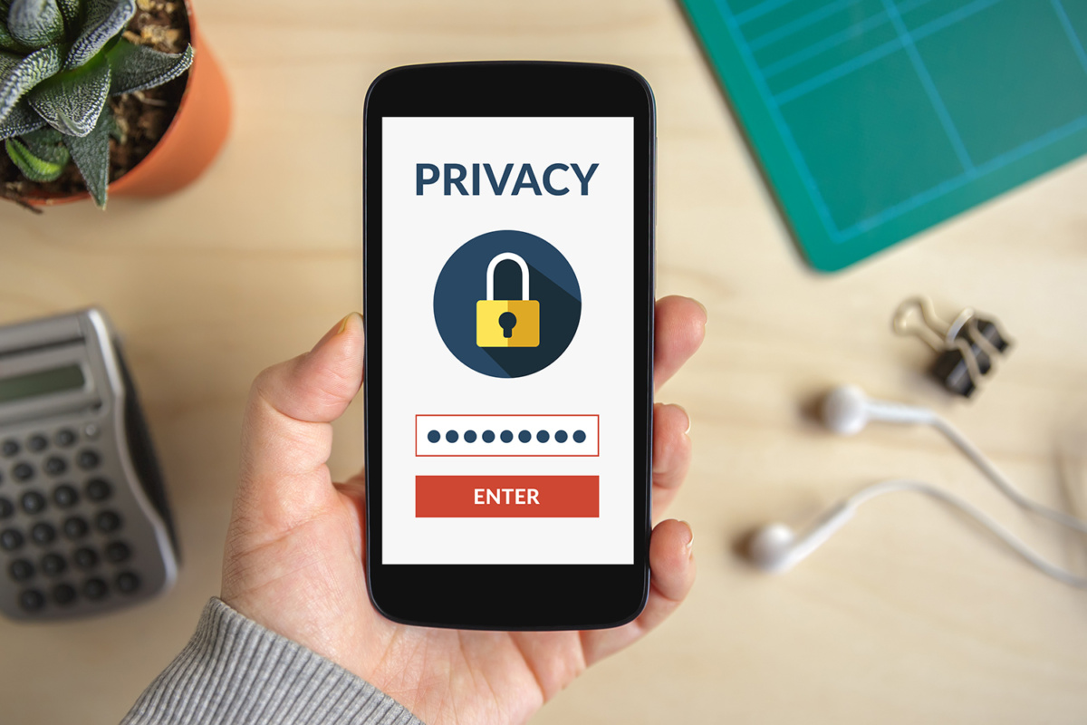
Mobile Phone Security
Student’s Name
Institutional Affiliation

Slide 2
Introduction
It is a process of designing security actions to protect crucial information in mobile devices.
The main aim of mobile phone security is to protect information.
Data saved in the device is secured in a way that unauthorized individuals will not access.
When the phone gets lost, strangers can hardly operate it due to security measures installed.
Notes:
Some of the mobile devices include smartphones, laptops and tablets.
Most mobile phones are purchased with in-build security systems while others require installation

Slide 3

Authentication
It is a security measure that involves developing passwords and usernames in the phones.
When using this method, the phone can only be accesses by someone with the security password.
However, the method does not provide fro the access rights (Ramalingam et al., 2017).
It is different from authorization which involves provides access through identity.
Notes:
Owner of the phone should put a password secretly to avoid disclosure.
Sharing passwords and username is a way of putting the device at risk.

Slide 4
Mobile Security Best Practice
It is a form of security installed in phones.
The method involves applying some guidelines on personal or business phones.
The guidelines used are similar in all types of phones.
Authentication is an example of the most popular guidelines.
In business sector, the information technology department is required to inform staff about the guidelines.
Notes:
Informed employees are able to maintain and improve security measures at work places.
Phone users can search and download the suitable security applications on their phones.
Phones should remain locked for security purpose.

Slide 5
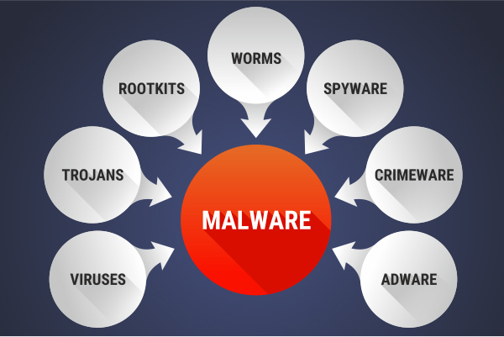
Malware
A malware is a system designed by malicious people to damage the system of the mobile phone.
There are different types of malware.
For example, a financial malware is use to access the financial information (Afianian et al., 2018).
Spyware is a malware that is capable of scanning all the saved information.
Notes:
Viruses and Trojan horse are examples of malware
Malware can be easily protected

Slide 6
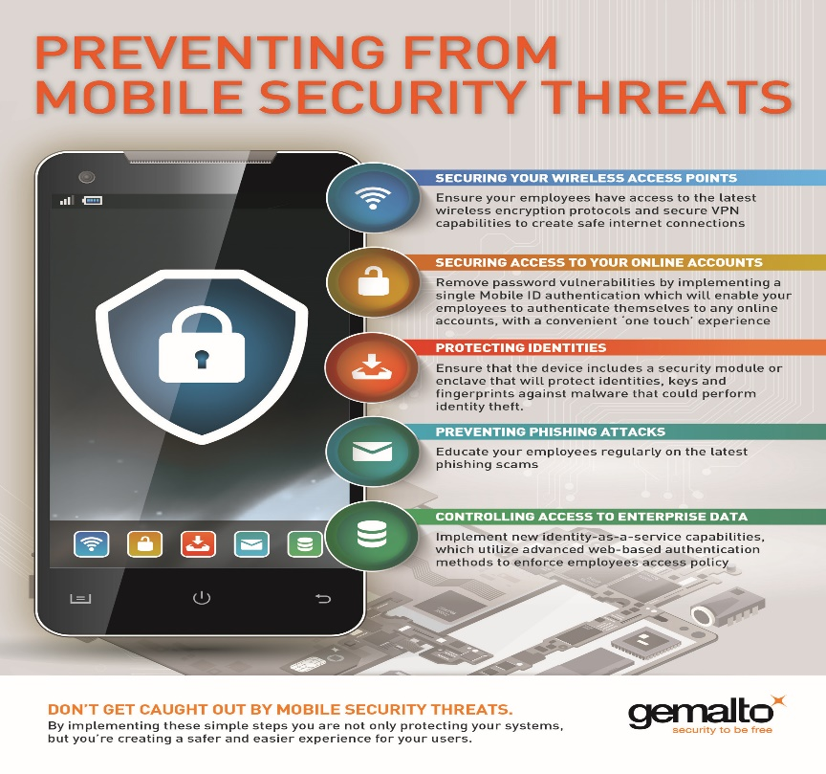
Mobile security threats
Theses are potential activities that can alter with stored information in bile phones.
The process can either be physical or software-based.
The threats include malware and spyware .
In most cases the threats occur in case of phone loss (Chen et al., 2017, p730).
Hackers put information in phones at risk.
Notes:
In physical threats, mobile phones without password are at high risk.
The main aim of hackers is to obtain sensitive information.
The threats can be posed through applications

Slide 7
Conclusion/Summary
Mobile phones security has been on the rise due to advanced technology.
People should learn about security measures to protect their devices.
Organizations must involve Information Technology specialists to safeguard their information.
Mobile phone producing companies should make phones with ready applications to provide security.
Individuals should avoid accessing others’ phones without owners’ authority.
The government should establish laws to deal with hackers and malicious people.

Slide 8
References
Ramalingam, M., Mathews, S. S., & Inbaraj, J. (2017). U.S. Patent No. 9,723,487. Washington, DC: U.S. Patent and Trademark Office.
Afianian, A., Niksefat, S., Sadeghiyan, B., & Baptiste, D. (2018). Malware Dynamic Analysis Evasion Techniques: A Survey. arXiv preprint arXiv:1811.01190.
Chen, M., Qian, Y., Mao, S., Tang, W., & Yang, X. (2016). Software-defined mobile networks security. Mobile Networks and Applications, 21(5), 729-743.

